Slide 1



Medi-Chat
LOGO
PROG8245
Final Project Dry On
Group Members:
Ce Chen 9007166
Haibo Yuan 9010929
Zhuoran Zhang 9048508
Abdallah Mohamed 9089339

Slide 2


行业PPT模板http://www.1ppt.com/hangye/
Medi-Chat
Problem Statement
Problem
Language Barrier
Medical Information in complex
User can’t easily understand symptoms
Solution
Multilingual chatbot
Translator to help understanding
Get simple and understandable answers

Slide 3

LOGO
Medi-Chat
System Architecture
User Query
↓
Language Detection
↓
Translation to English
↓
Intent Classification
↓
Response Generation
↓
Translation to User Language
↓
Final Answer
Notes:
模板来自于：第一PPT https://www.1ppt.com/

Slide 4
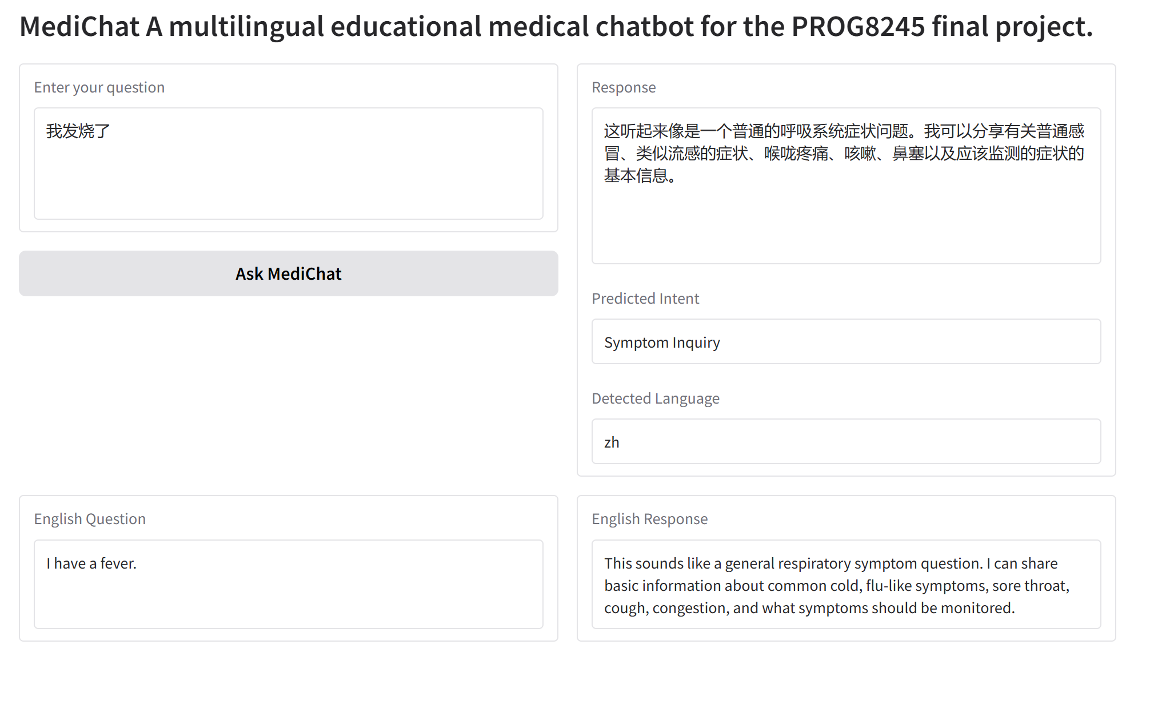
LOGO
Medi-Chat
Demonstration
Input in any language
Translate output into original language
Intent Classification
Language Detection
Translate it into English
Output
Notes:
模板来自于：第一PPT https://www.1ppt.com/

Slide 5
行业PPT模板http://www.1ppt.com/hangye/
Medi-Chat
Impact & Limitations
Impact
Improves accessibility to medical information
Helps non-English users understand symptoms
Provides simple and educational explanations
Limitations
Not a medical diagnosis tool
Depends on translation accuracy
Limited understanding of complex cases

Slide 6
行业PPT模板http://www.1ppt.com/hangye/
Medi-Chat
Development Roadmap
Completed Work
Repository setup with Git & DVC
Baseline model (TF-IDF + Naive Bayes)
Multilingual pipeline (language detection & translation)
Future Work
Integrate real medical dataset
Model evaluation and comparison
Build full web application (UI & audio support)
Improve model performance and user experience

